Slide 1
Making your own website with GitHub Pages
James Goldie
1 November 2017

Slide 2
Git is version control.

Slide 3
Ever lost track of your work?

Slide 4
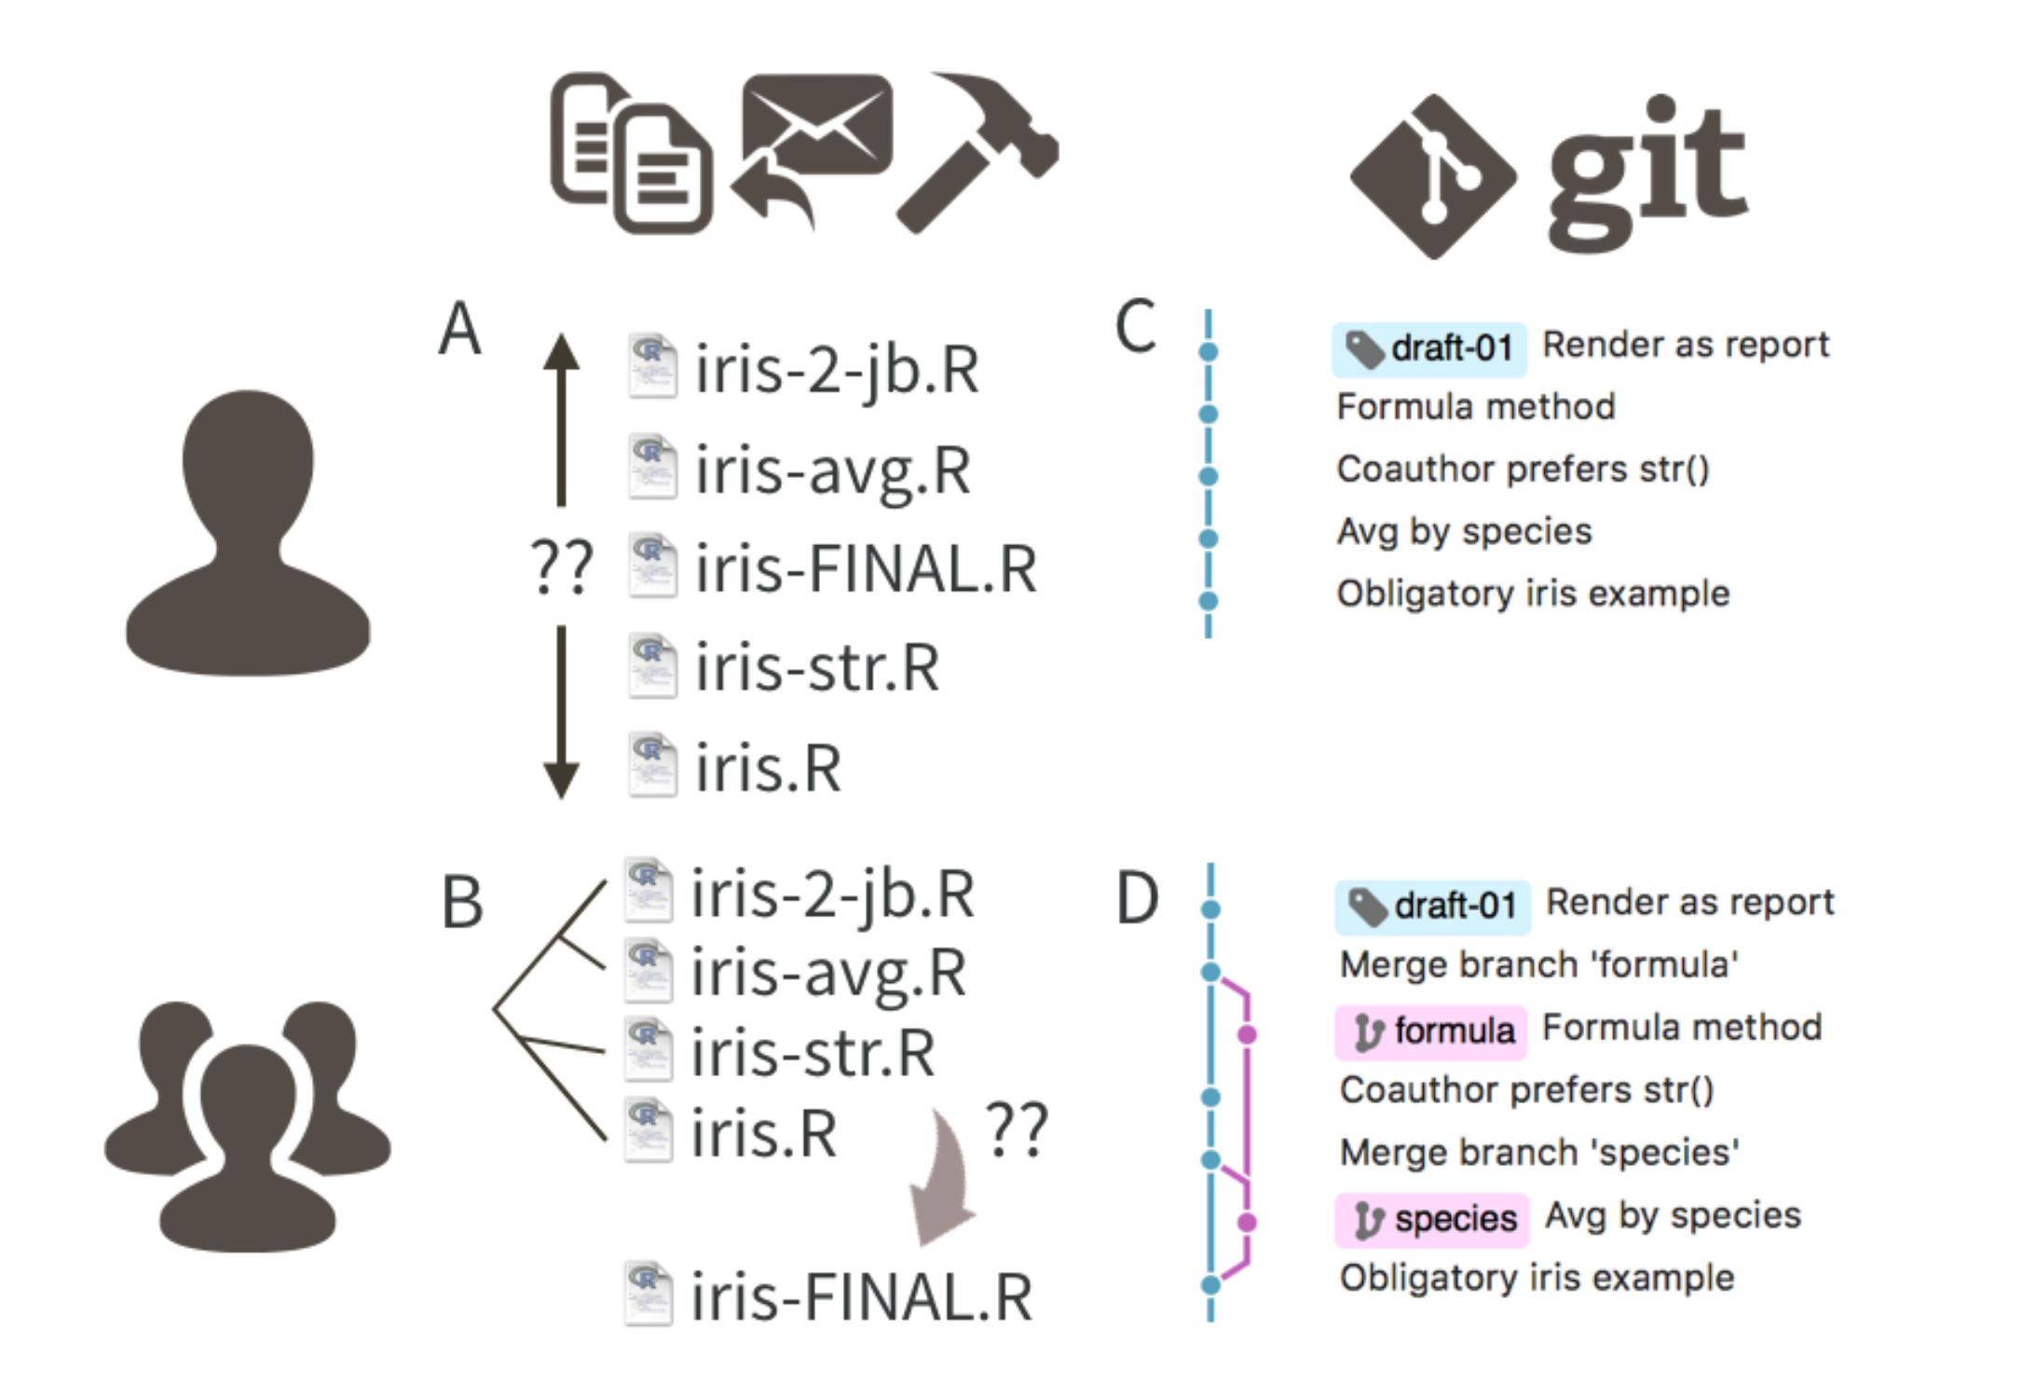
Bryan, J. “Excuse Me, Do You Have a Moment to Talk about Version Control?” PeerJ Preprints, August 28, 2017. https://doi.org/10.7287/peerj.preprints.3159v2.

Slide 5
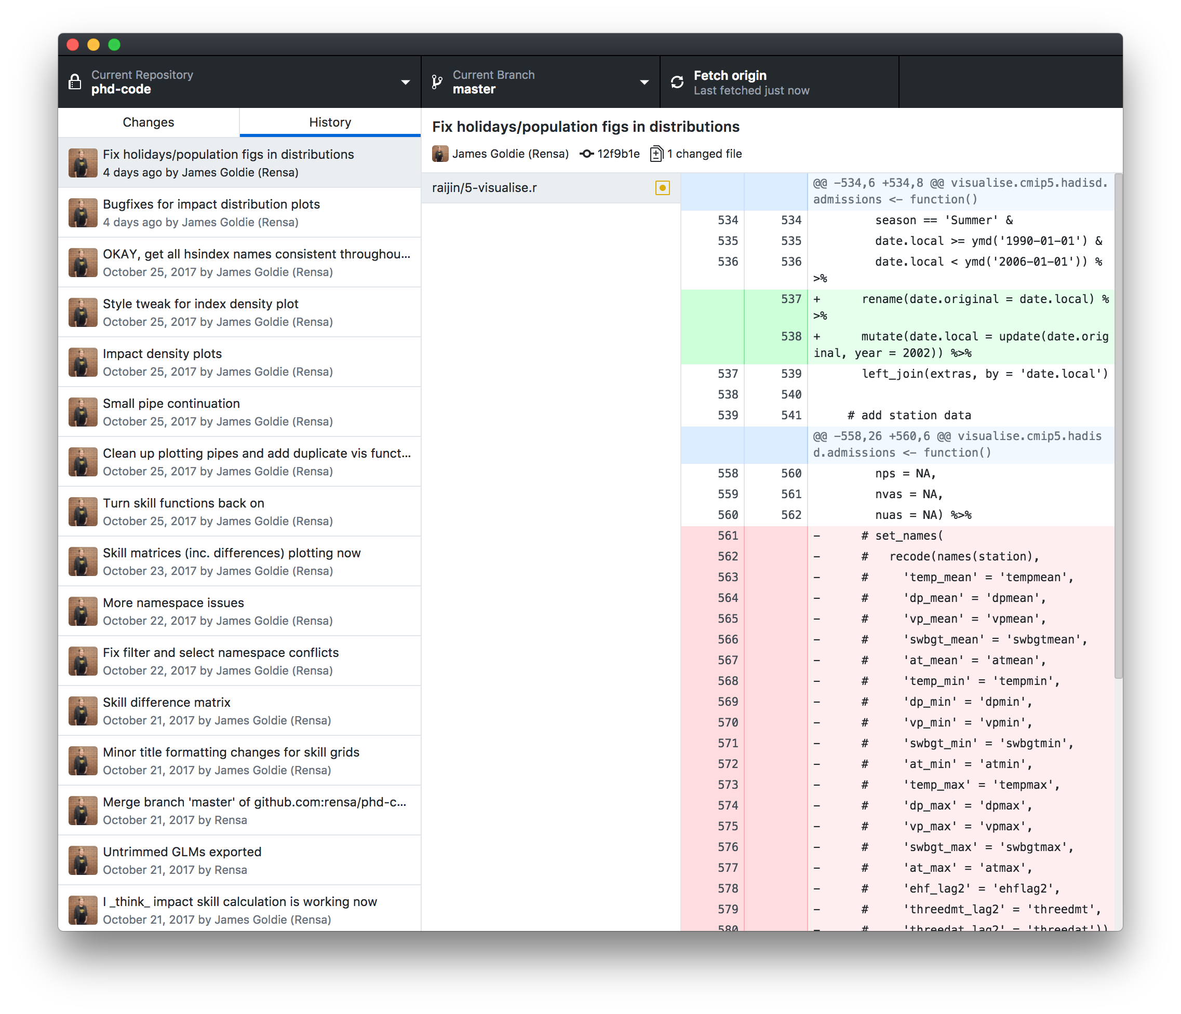
Notes:
You can see when you did things,
where you left off,
when other people made contributions
This is my repo for my PhD code

Slide 6
Share your work and improve other people’s

Slide 7
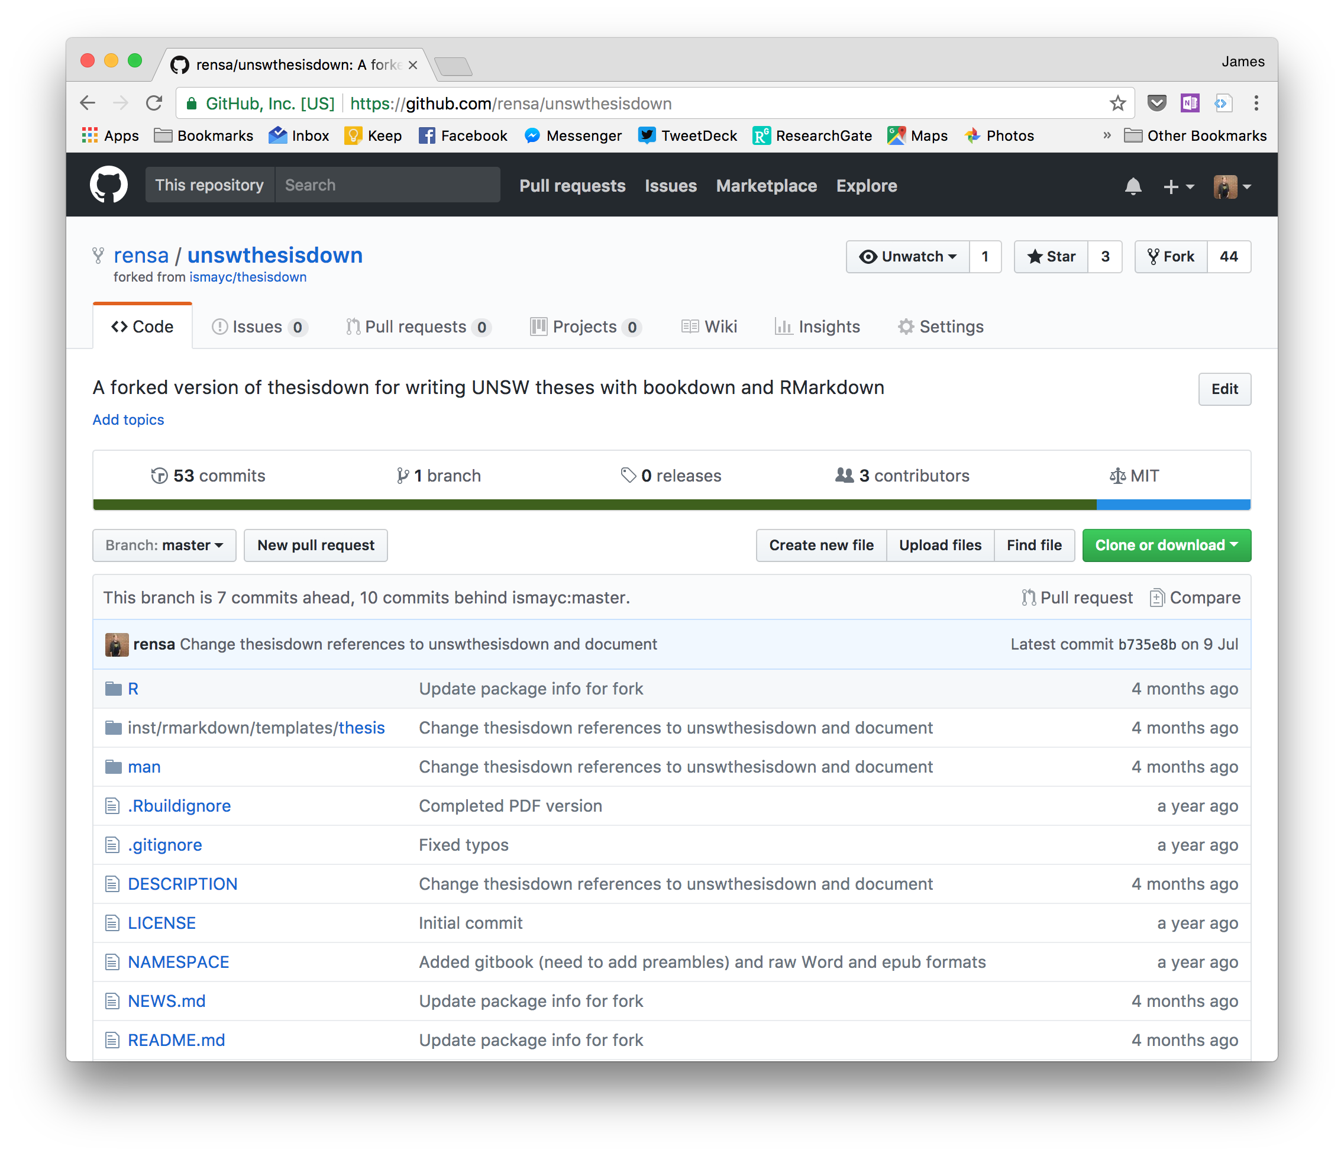

Slide 8
GitHub is a website that hosts git projects

Slide 9
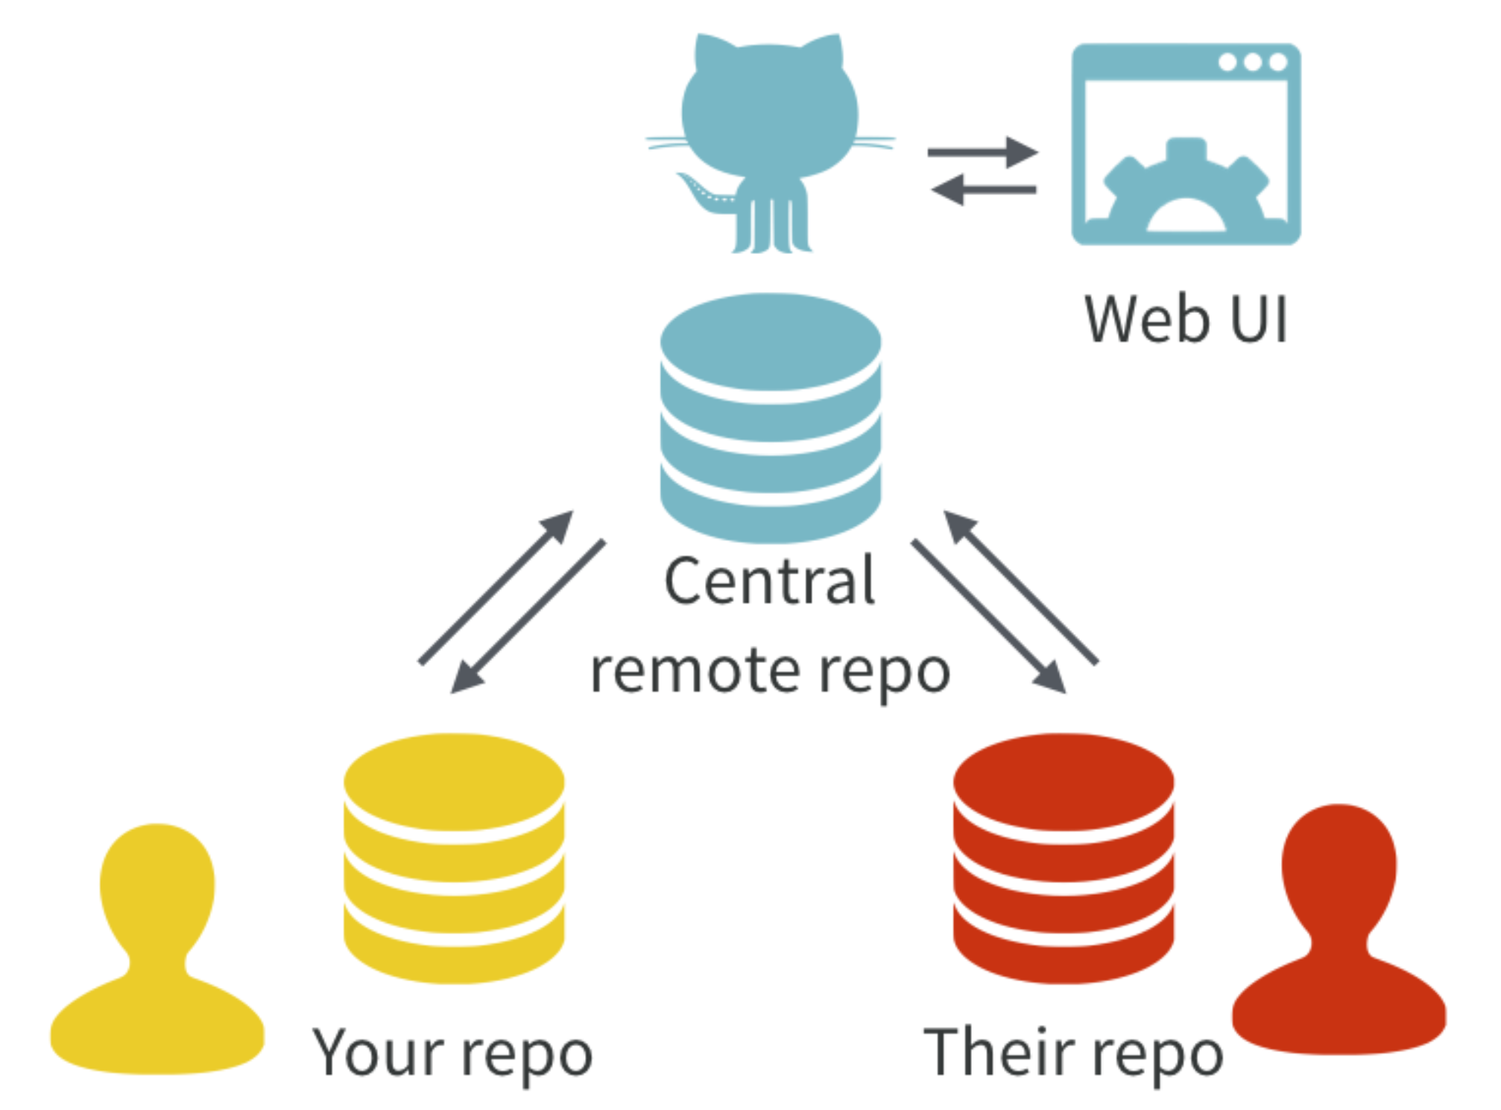
Bryan, J. “Excuse Me, Do You Have a Moment to Talk about Version Control?” PeerJ Preprints, August 28, 2017. https://doi.org/10.7287/peerj.preprints.3159v2.
Notes:
People can have their own copies of a project, or REPO
They can work independently
And reconcile (‘merge’) their updates

Slide 10
THE GIT WORKFLOW: work, add, commit work, add, commit work, add, commit work, add, commit work, add, commit

Slide 11
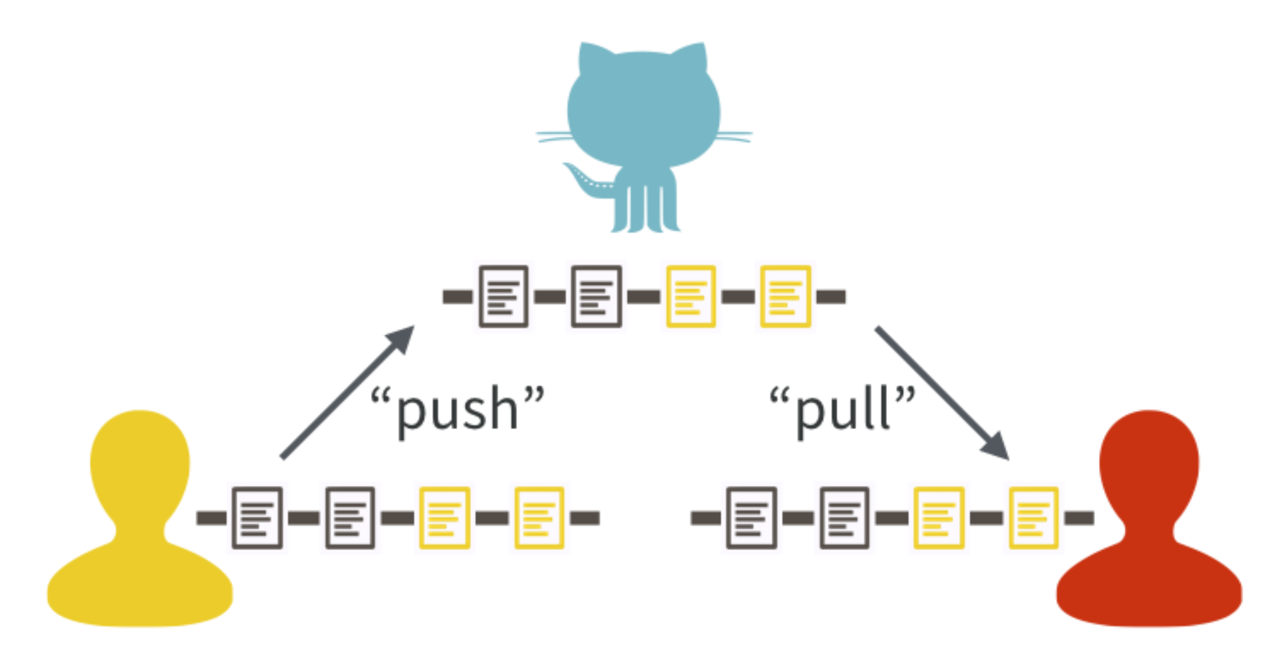
Bryan, J. “Excuse Me, Do You Have a Moment to Talk about Version Control?” PeerJ Preprints, August 28, 2017. https://doi.org/10.7287/peerj.preprints.3159v2.
Notes:
As well as adding and commiting, we need to know about pushing and pulling.
Pulling downloads any changes that others have made from Github and merges them with our work.
Pushing uploads our work to Github.

